Slide 1
IN AN ELECTION WAR ROOM
ASSIGNMENT
Shubh Tandon (200964) &
Rishi Kachhwaha (200793)

Slide 2
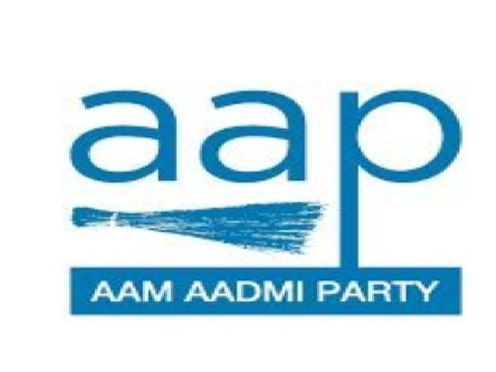
1) Detailed strategy for the aam aadmi party for the upcoming Gujarat Assembly Elections 2022.

Slide 3
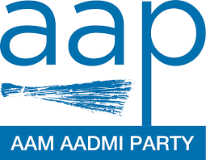
Aam Aadmi Party
Here we are talking about party emerged as nation’s greatest political start-up recently, After complete sweep in Punjab election held recently, AAP has became only non UPA or NDA party to have their government in 2 states, including Delhi where they seemed to be in total control since 2015. All these success is within 9 years after party came into existence.
But for a regional party to become pan India party doesn’t seems to a cup of tea, especially after seeing direct fight between UPA and NDA since 30 years. We have also seen Mayawati’s BSP trying to expand its base to all India since 20 years but she not even failed to expand but also lost are own roots.

Slide 4

Immediate challenge in the way
Now we see ever boosted AAP cader preparing for upcoming Gujarat election where they are daring to take horn directly against ever powerful BJP as Gujarat is the home turf of current core BJP leadership.
Also to be noted, Gujarat never seemed to have 3rd party system ever. Always there is direct fight between BJP and congress.
But as we saw in recent elections, it is never impossible for AAP to challenge major leadership of states. So here, we present major suggestions to the party to bring their political aspiration to zenith in state of Gujarat-

Slide 5

Major leadership Issue in Gujarat
Though Gujarat is the land of arguably most popular political leader of the world, our prime minister Narendra Modi, but the harsh reality is that the states is facing huge leadership crisis post Modi-shah era.
Even congress, after Hardik Patel leaving party, is not having any leader there who could have complete command over state. This is the weakest vein of existing parties which AAP could hold Around this point, the whole election Campaign of APP could revolve.

Slide 6
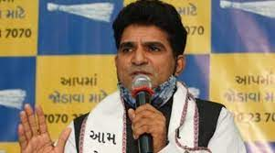
AAP’s star leader
To challenge scarcity of pan- Gujarat leader, AAP should also have a leader there who is famous among Gujaratis.
Isudan Gadhvi, former journalist who joined party last year is very famous in Gujarat. So much so that is famously called Arnab of Gujarat.
Party could project him as a pre declared CM face and challenge BJP and congress to have face of his capability as both parties doesn’t seem to have CM face before.

Slide 7

Target Voters
One of the major part of electoral strategy is to have a target voter for the party. Party must aim to have their say among section of society so that their popularity must be reflected in score sheet of constituencies won.
Gujarat is said to have a higher count of urban population compared to rest of India and that’s where AAP can aim to apply their Delhi model. Urban population would care about good schooling + good health, a point which paved major way to their success in Delhi.

Slide 8

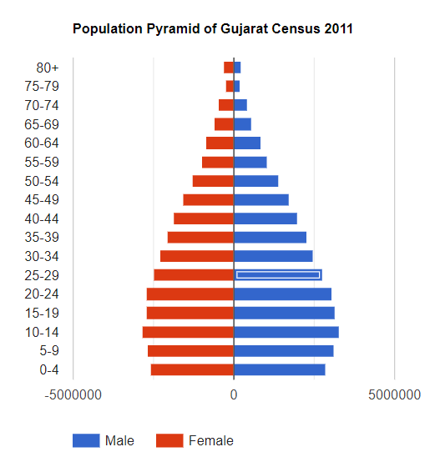
Target voters
One of the reason for Punjab success of AAP was woman voter.
There scheme to give Punjab woman 1000 rupees per month paved a huge path for their success there as majority of woman vote swung completely to their sides.
Other target could be youth.
India’s youth is pretty fascinated by schooling in Delhi and is considering to have this Delhi model of governance in their state. About 25% of Gujarat voters are in age gap of 18-35 which provides huge chunk of votes to be accumulated.

Slide 9
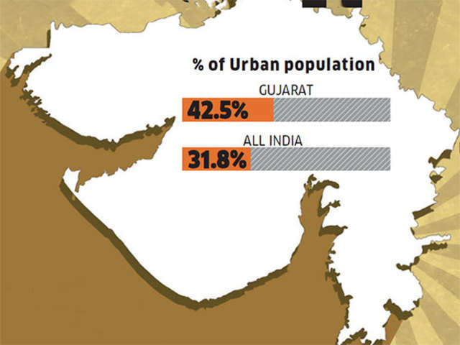
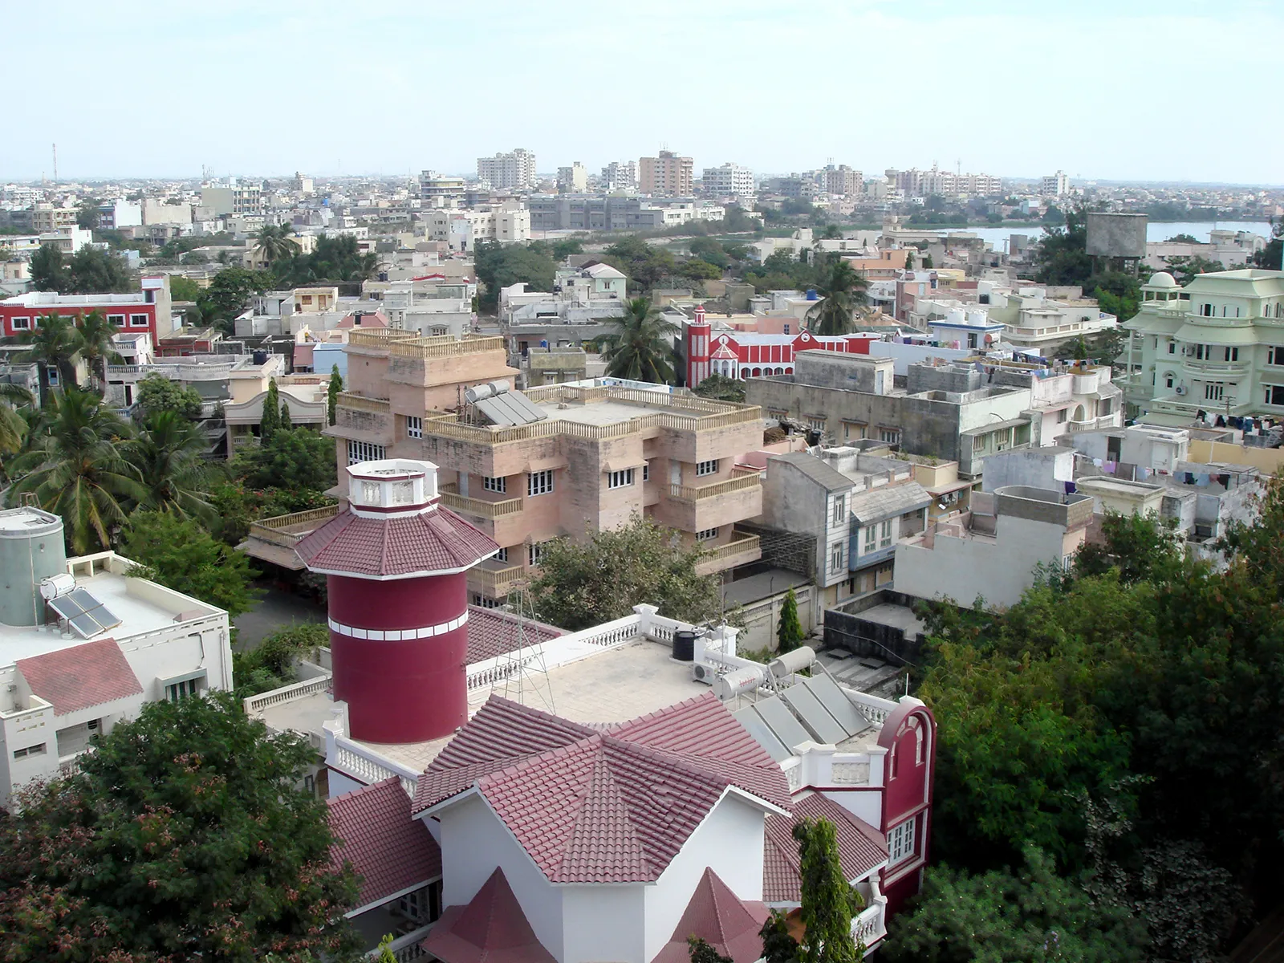
Urban Majority
Urban population indicates that AAP has a real chance to present their Delhi model, as urban people would love to have good government school and better health condition.

Slide 10
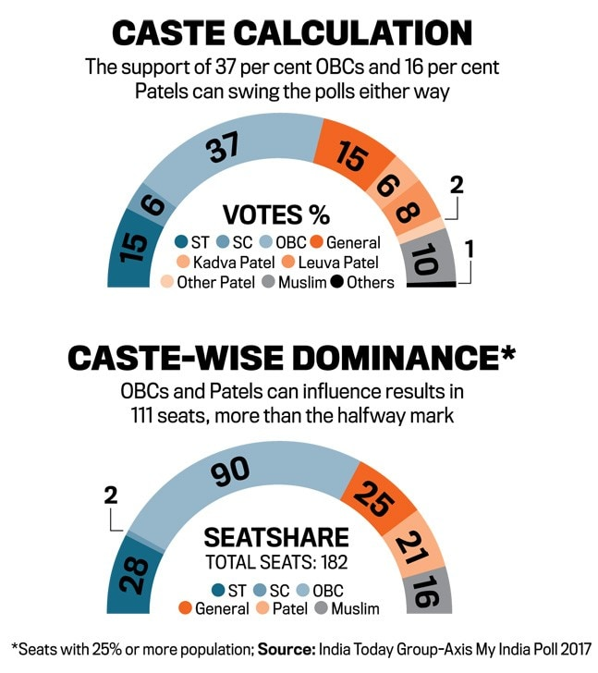
Caste Politics
It is often seen in Gujarat that Patels plays decisive role in elections here.
Hardik Patel started camping Patels against BJP but now with him back in BJP camp, AAP can present themselves as a better representation of Patels.
10% Muslims in Gujarat are also looking to have a better representation as the one Upset with BJP since Godhra are not able to turn them out of power by Backing Congress.

Slide 11
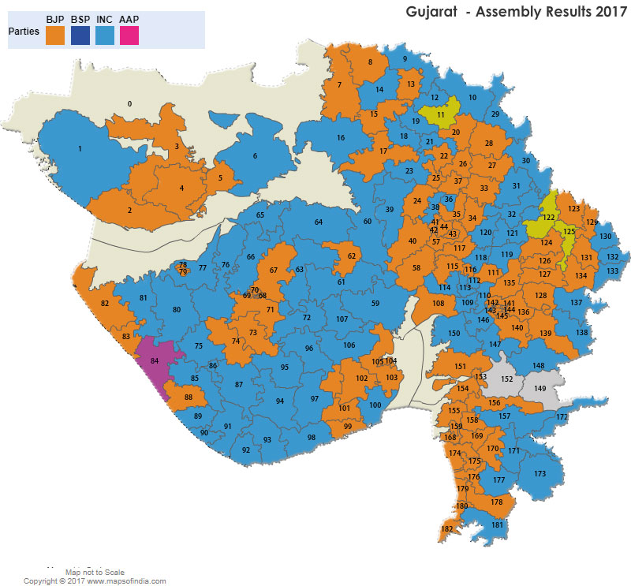
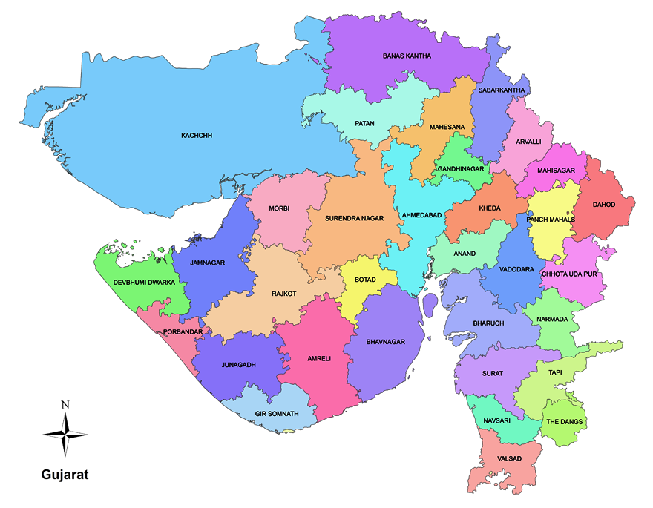
2017 Assembly Election results
Strategy on map on next page →

Slide 12
Studying Constituencies
Based on above map, we can make out that barring Ahmedabad and Vadodara constituencies most of the Gujarat is facing tussle of power between INC and BJP as win margins between both parties is marginal.
With people not going one way, AAP can make realistic chance within non-vocal and non-firm voters of a constituency.
Recent AAP success in Surat and nearby region in municipality elections suggests that Aam Aadmi Party is getting in mind of voters of Surat, especially the Business class who are fed-up with polies of previous Governments.
Gandhinagar GMC elections suggests that huge vote bank of Congress is shifting towards AAP as it bagged 21% of votes there. Triangular battles like in Gandhinagar could prove to be very useful for AAP.

Slide 13

Star Campaigners
Gujarati people would love if a party provides its motherland representative.
Experts believe that current state leadership of BJP have no command among people but it the feeling of Gujaratis of BJP giving its homeland’s PM that’s why BJP managed to marginal victory in 2017.
For AAP, their over dependence on national convener Arvind Kejriwal won’t work here. They should focus on local leaders, who speaks in gujarati, have a sense of belonging to the people of Gujarat.
Prominent faces of AAP in Gujarat includes Isudan Gadhvi, Indranil Rajguru, Gopal Italia to name a few.
These can be their go-to campaigners as the one is famous TV face for Gujarat and others have been in political set-up for years.
While famous Delhi faces can hold an internal strategy role and have some mega road shows in area of dominance.

Slide 14
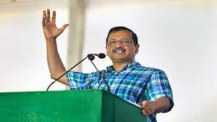
Issues in Gujarat and AAP’s Promises
Corruption - Ahead of the Gujarat Assembly elections due later this year, Delhi Chief Minister Arvind Kejriwal on Monday said he will visit the state every week to interact with the public on various issues like corruption and farming, and claimed it was possible to provide free electricity to people if they bring an "honest party" to power in the state.
Electricity issues - Kejriwal said if Gujarat ministers can enjoy zero electricity bills despite consuming thousands of units, then why not the general public.
"Today, we should discuss electricity. We will discuss other issues as well. I will visit Gujarat every week and hold 'jan samvad' (public dialogue) on the issues of corruption, agriculture, MSP (minimum support price)," he said.

Slide 15
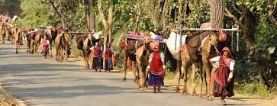
Minority group related issue - “We are well aware of the exploitation and injustice faced by the adivasi community in Gujarat – first at the hands of the British, then tortured by our own people,” the AAP chief said. “It is highly ironic that while the two richest men of our country hail from Gujarat, the most impoverished tribals also belong to this state.”
Gujarat schools - ‘Kick us out if...’ AAP chief Kejriwal vows to revamp Gujarat schools

Slide 16
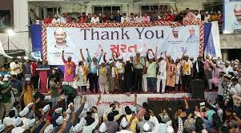
Campaigning
Kejriwal said he knows the way to end corruption, and while in Delhi corruption has ended, Mann has cleaned up the system in Punjab within 10 days of taking charge, he claimed.
“I haven’t come here to defeat either BJP or Congress, but to make Gujarat and Gujaratis win,” Kejriwal said during the roadshow.
Alleging that the ruling BJP has become arrogant with power, Kejriwal asked the people to give AAP a chance and change later if the party doesn’t live up to their expectations.

Slide 17
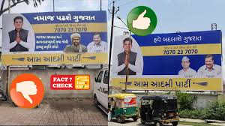
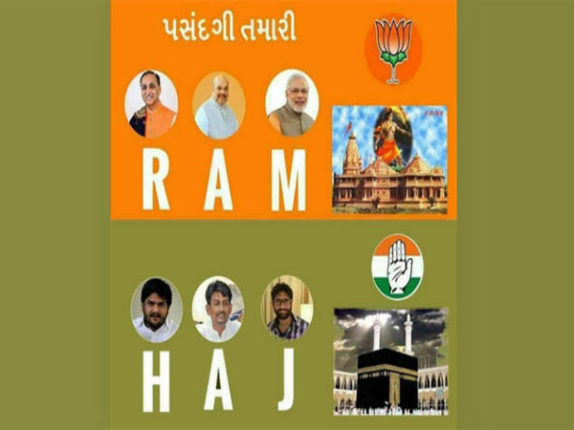
Refrain from Dirty Politics
Unlike other parties who are doing dirty politics in name of religion and defaming others, AAP is focussing on infrastructural development promises to gain votes.

Slide 18
2) 5-point long-term plan, for the party to emerge as the official opposition in the Lok Sabha Elections of 2029.

Slide 19
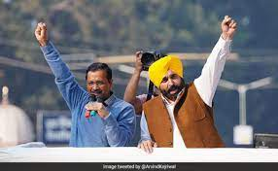
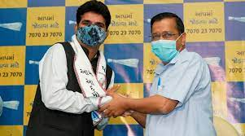
1) More active faces
Just like AAP had Arvind Kejriwal for Delhi election and Bhagwant Mann for Punjab election and now Isudan Gadhvi in Gujarat, they need to keep giving party tickets to famous personalities who do ground work and could reach the local citizens.
BJP gets votes majorly for one man’s face, Narendra Modi, even if its state elections or central. So in order to compete with that AAP needs some strong faces too plus the work they are doing.

Slide 20
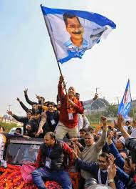
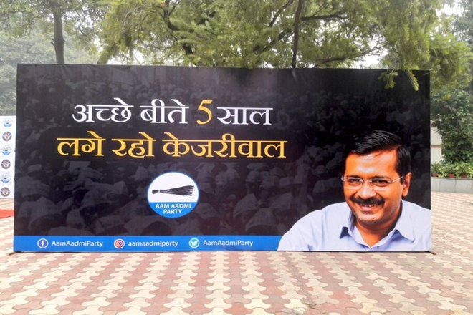
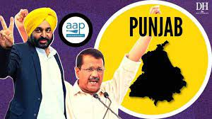
2) More model states
AAP was successful in solving major public issues like govt. school infrastructure, electric power cuts, etc., GDP growth, job vacancies etc in Delhi also add points in favour of AAP.
Thus AAP can present these outputs while campaigning for other state elections, then after winning they can work hard to make that state a model state too.
Thus gaining more votes due to impressed public.

Slide 63
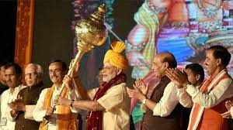
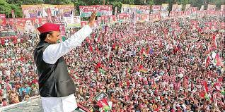
3) Religious/Caste politics
AAP’s agenda has always been gathering votes on basis of the work they did, they never did religious or caste polarisation like other parties do and it is a plus point for them.
There is no grp of community who feel like AAP is being biased and not noticing their issues. Thus this image of ‘everyone’s’ party will help them gain votes of every community.
Unlike - Samajwadi Party (Muslims, Yadavs)
BJP (Upper class Hindus, andh bhakt)

Slide 258
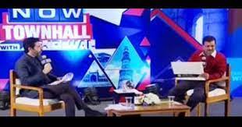
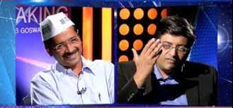
4) Media Influence
In Godi Media Era you can’t expect anything from media channels that they’ll show real issues instead of praising prime minister and downgrading other political leaders and parties.
In 2019 elections, congress boycotted and avoided these media channels as much as they can and they lost the election the thing is…“What you see is sold”.
AAP on the other hand did opposite during delhi elections, kejriwal and spokespersons went to news channels and gave answers to the anchors which was highly praised by audience, this was one of the big reasons they won.

Slide 259
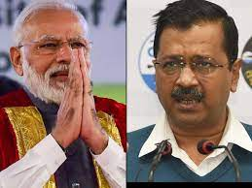
5) Not comprising with national parties!!
Kejriwal slams both existing biggest parties in India BJP and Congress.
For congress his statements like “If Congress Had Worked, No Need For Me To Join Politics” and “Don't Waste Votes On Congress” with these statements ‘andh bhakts’ will not change but the people who wants development and voting for congress just because their family used to, will now lean towards AAP’s philosophy. And slowly due to congress public now supporting AAP, sooner or later they’ll become the biggest opposition.
and when it comes for bjp kejriwal says - 'Those not satisfied with BJP must vote for AAP'. Already giving people a mindset that “if not modi then who” is false, AAP is there for public, they can give AAP a chance if BJP does not satisfies the them.

